Slide 1

INTRODUCTION TO STATISTICS AND PROBABILITY

Slide 2
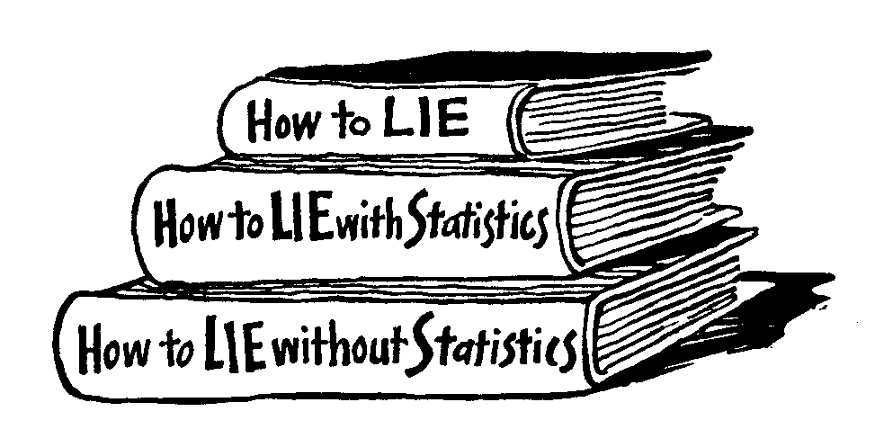
INTRODUCTION TO STATISTICS
“There are three kinds of lies: lies, damned lies, and statistics.“ -(B.Disraeli)

Slide 3
MOTIVATION TO STUDY STATISTICS
DATA IS EVERYWHERE AROUND YOU
STATISTICAL TECHNIQUES ARE USED BY ALL THE TIME TO MAKE BETTER DECISIONS THAT AFFECT OUR LIVES
NO MATTER WHAT YOUR CAREER IS, YOU WILL PROFESSIONAL DECISIONS BASED ON DATA. WHY NOT USE THE DATA IN AN EFFICIENT WAY!
STATISTICAL TECHNIQUES WILL HELP YOU THINK IN A DATA-DRIVEN WAY

Slide 4
REAL BUSINESS WORLD APPLICATIONS THAT USE STATISTICS
FINANCE – CORRELATION AND REGRESSION, INDEX NUMBERS, TIME SERIES ANALYSIS
MARKETING – HYPOTHESIS TESTING, CHI-SQUARE TESTS, A/B TESTING
PERSONAL – HYPOTHESIS TESTING, CHI-SQUARE TESTS, NONPARAMETRIC TESTS
OPERATING MANAGEMENT – HYPOTHESIS TESTING, ESTIMATION, ANALYSIS OF VARIANCE (ANOVA), TIME SERIES ANALYSIS

Slide 5
WHAT IS STATISTICS?
THE SCIENCE OF COLLECTING, ORGANIZING, PRESENTING, ANALYZING, AND INTERPRETING DATA TO ASSIST IN MAKING MORE EFFECTIVE DECISIONS
STATISTICAL ANALYSIS – USED TO MANIPULATE SUMMARIZE, AND INVESTIGATE DATA, SO THAT USEFUL DECISION-MAKING INFORMATION RESULTS.

Slide 6
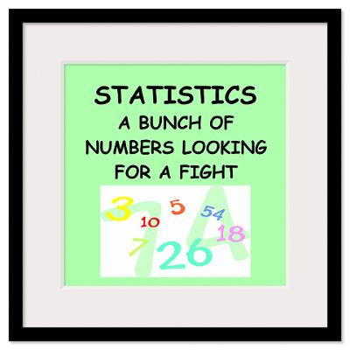
WHAT IS STATISTICS?
THE SCIENCE OF COLLECTING, ORGANIZING, PRESENTING, ANALYZING, AND INTERPRETING DATA TO ASSIST IN MAKING MORE EFFECTIVE DECISIONS
STATISTICAL ANALYSIS – USED TO MANIPULATE SUMMARIZE, AND INVESTIGATE DATA, SO THAT USEFUL DECISION-MAKING INFORMATION RESULTS.

Slide 7
TYPES OF STATISTICS
FREQUENTIST: frequentists compare the data they see to what they expected. That is, they have a mental model on how frequent something should happen, and then see data and how often it did happen
BAYESIAN: Bayesian people, on the other hand, combine their mental models. That is, they have a model based on their previous experiences (prior) that tells them what they think the data should look like, and then they combine this with the data they observe to settle upon some “posterior” belief
Example:
I have misplaced my phone somewhere in the home. I can use the phone locator on the base of the instrument to locate the phone and when I press the phone locator the phone starts beeping.
Problem: Which area of my home should I search?
Frequentist Reasoning
I can hear the phone beeping. I also have a mental model which helps me identify the area from which the sound is coming. Therefore, upon hearing the beep, I infer the area of my home I must search to locate the phone.
Bayesian Reasoning
I can hear the phone beeping. Now, apart from a mental model which helps me identify the area from which the sound is coming from, I also know the locations where I have misplaced the phone in the past. So, I combine my inferences using the beeps and my prior information about the locations I have misplaced the phone in the past to identify an area I must search to locate the phone.

Slide 8
FREQUENTIST STATISTICS
DESCRIPTIVE STATISTICS: METHODS OF ORGANIZING, SUMMARIZING, AND PRESENTING DATA IN AN INFORMATIVE WAY
INFERENTIAL STATISTICS: THE METHODS USED TO DETERMINE SOMETHING ABOUT A POPULATION ON THE BASIS OF A SAMPLE
  POPULATION –THE ENTIRE SET OF INDIVIDUALS OR OBJECTS OF INTEREST OR THE MEASUREMENTS OBTAINED FROM ALL INDIVIDUALS OR OBJECTS OF INTEREST
  SAMPLE – A PORTION, OR PART, OF THE POPULATION OF INTEREST

Slide 9
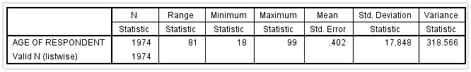
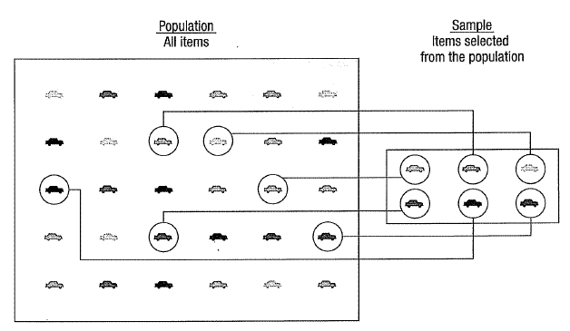
TYPES OF STATISTICS…..
DESCRIPTIVE: DESCRIBING THE DATA TO GET MAX INFO
INFERENTIAL: TAKING A SAMPLE TO UNDERSTAND THE POPULATION

Slide 10
MAJOR PARAMETERS IN EACH TYPE
DESCRIPTIVE | INFERENTIAL
COLLECTING, ANALYZING AND PRESENTING DATA | COLLECTING SAMPLE FROM A DATA WHEN POPULATION IS HUGE
CENTRAL MEASURES OF TENDENCY: MEAN, MEDIAN, MODE | ESTIMATION USING SAMPLING: EG. ESTIMATE THE WEIGHT OF THE POPULATION USING A SAMPLE
MEASURES OF DISPERSION: STANDARD DEVIATION, VARIANCE, COVARIANCE | HYPOTHESIS TESTING: TEST THE CLAIM THAT THE WEIGHT OF THE POPULATION IS 70KG

Slide 11
STATISTICAL DATA: TERMS
THE COLLECTION OF DATA THAT IS RELEVANT TO THE PROBLEM BEING STUDIED IS COMMONLY THE MOST DIFFICULT, EXPENSIVE, AND TIME-CONSUMING PART OF THE ENTIRE RESEARCH PROJECT
STATISTICAL DATA ARE USUALLY OBTAINED BY COUNTING OR MEASURING ITEMS.
  PRIMARY DATA ARE COLLECTED SPECIFICALLY FOR THE ANALYSIS DESIRED
  SECONDARY DATA HAVE ALREADY BEEN COMPILED AND ARE AVAILABLE FOR STATISTICAL ANALYSIS
A VARIABLE IS AN ITEM OF INTEREST THAT CAN TAKE ON MANY DIFFERENT NUMERICAL VALUES: JUST LIKE VARIABLES WE CREATED IN PYTHON!
A CONSTANT HAS A FIXED NUMERICAL VALUE

Slide 12
TYPES OF DATA
STATISTICAL DATA ARE USUALLY OBTAINED BY COUNTING OR MEASURING ITEMS. MOST DATA CAN BE PUT INTO THE FOLLOWING CATEGORIES:
QUALITATIVE - DATA ARE MEASUREMENTS THAT EACH FAIL INTO ONE OF SEVERAL CATEGORIES. (HAIR COLOR, ETHNIC GROUPS AND OTHER ATTRIBUTES OF THE POPULATION)
QUANTITATIVE - DATA ARE OBSERVATIONS THAT ARE MEASURED ON A NUMERICAL SCALE (DISTANCE TRAVELED TO COLLEGE, NUMBER OF CHILDREN IN A FAMILY, ETC.)

Slide 13
QUALITATIVE DATA
QUALITATIVE DATA ARE GENERALLY DESCRIBED BY WORDS OR LETTERS. THEY ARE NOT AS WIDELY USED AS QUANTITATIVE DATA BECAUSE MANY NUMERICAL TECHNIQUES DO NOT APPLY TO THE QUALITATIVE DATA.
FOR EXAMPLE, IT DOES NOT MAKE SENSE TO FIND AN AVERAGE HAIR COLOR OR BLOOD TYPE.
QUALITATIVE DATA CAN BE SEPARATED INTO TWO SUBGROUPS:
DICHOTOMIC /BINARY (IF IT TAKES THE FORM OF A WORD WITH TWO OPTIONS (GENDER - MALE OR FEMALE)
POLYNOMIC/MULTI-CLASS (IF IT TAKES THE FORM OF A WORD WITH MORE THAN TWO OPTIONS (EDUCATION - PRIMARY SCHOOL, SECONDARY SCHOOL AND UNIVERSITY).

Slide 14
QUANTITATIVE DATA
QUANTITATIVE DATA ARE ALWAYS NUMBERS AND ARE THE RESULT OF COUNTING OR MEASURING ATTRIBUTES OF A POPULATION.
QUANTITATIVE DATA CAN BE SEPARATED INTO TWO SUBGROUPS:
DISCRETE (IF IT IS THE RESULT OF COUNTING (THE NUMBER OF STUDENTS OF A GIVEN ETHNIC GROUP IN A CLASS, THE NUMBER OF BOOKS ON A SHELF, ...):
  IT CAN ONLY ASSUME CERTAIN VALUES
CONTINUOUS (IF IT IS THE RESULT OF MEASURING (DISTANCE TRAVELED, WEIGHT OF LUGGAGE, …)
  IT CAN ASSUME ANY VALUE POSSIBLE WITHIN A STATED LIMIT

Slide 15

TYPES OF DATA…..
VARIABLES
QUANTITATIVE
QUALITATIVE
BINARY
MULTI-CLASS
DISCRETE
CONTINUOUS

Slide 16
SCALES OF MEASUREMENT: HOW TO ACTUALLY MEASURE AND COMPARE DATA?
SCALES OF MEASUREMENT ALLOWS US TO DETERMINE THE BEST WAY OF DATA SUMMARIZATION.
NOMINAL – CONSIST OF CATEGORIES IN EACH OF WHICH THE NUMBER OF RESPECTIVE OBSERVATIONS IS RECORDED. THE CATEGORIES ARE IN NO LOGICAL ORDER AND HAVE NO PARTICULAR RELATIONSHIP. THE CATEGORIES ARE SAID TO BE MUTUALLY EXCLUSIVE SINCE AN INDIVIDUAL, OBJECT, OR MEASUREMENT CAN BE INCLUDED IN ONLY ONE OF THEM. (EG: COLORS IN A COLORING SET, CANDIDATE OPTIONS IN A VOTING BOOTH)
ORDINAL – CONTAIN MORE INFORMATION. MOSTLY USED FOR RANKING OF RESPONSES. CONSISTS OF DISTINCT CATEGORIES IN WHICH ORDER IS IMPLIED. VALUES IN ONE CATEGORY ARE LARGER OR SMALLER THAN VALUES IN OTHER CATEGORIES (E.G. RATING-EXCELLENT/FAIR/SATISFACTORY, GOOD/ POOR)

Slide 17
SCALES OF MEASUREMENT…..
INTERVAL – IS A SET OF NUMERICAL MEASUREMENTS IN WHICH THE DISTANCE BETWEEN NUMBERS IS OF A KNOWN, CONSTANT SIZE: (E.G: STRONGLY AGREE IS 5 WHEREAS STRONGLY DISAGREE IS 1)
RATIO – CONSISTS OF NUMERICAL MEASUREMENTS WHERE THE DISTANCE BETWEEN NUMBERS IS OF A KNOWN, CONSTANT SIZE, IN ADDITION, THERE IS A NONARBITRARY ZERO POINT. (E.G. HAVING ZERO LENGTH OR ZERO MONEY MEANS THAT THERE IS NO LENGTH AND NO MONEY)
http://www.mnestudies.com/research/types-measurement-scales

Slide 18
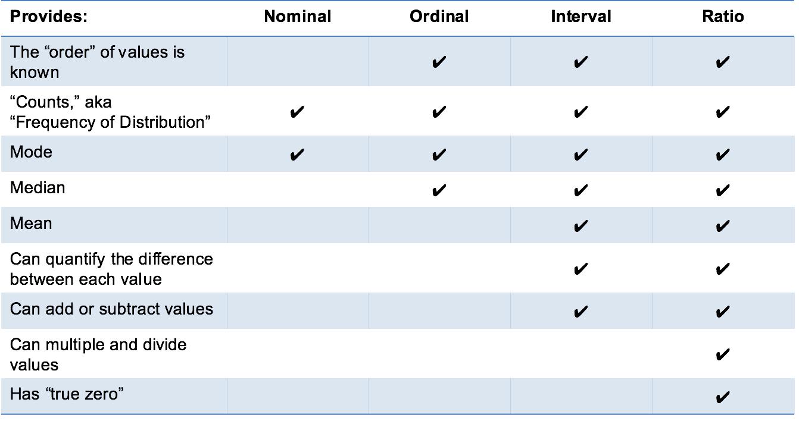
A TABLE TO RULE ‘EM ALL..

Slide 19
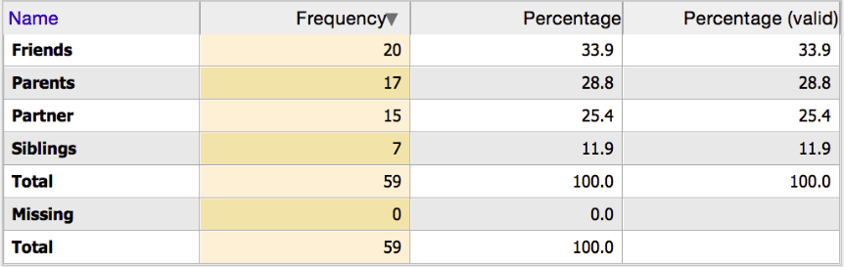
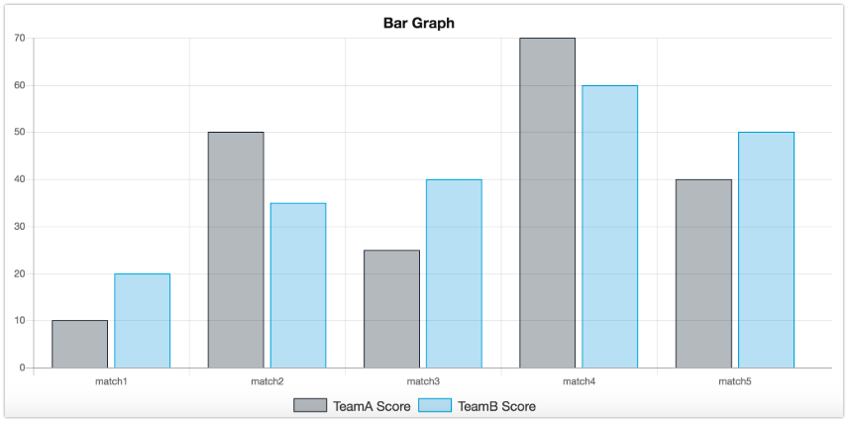
DATA SUMMARISATION AND PRESENTATION
WE USE TABULAR AND GRAPHICAL METHODS TO SUMMARISE QUALITATIVE DATA
  FREQUENCY DISTRUBUTION TABLE
  BAR GRAPH

Slide 20
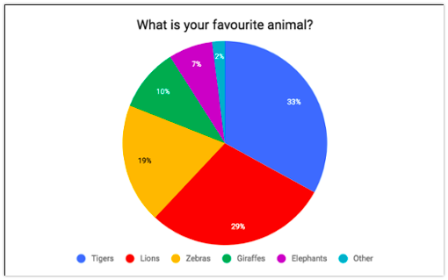
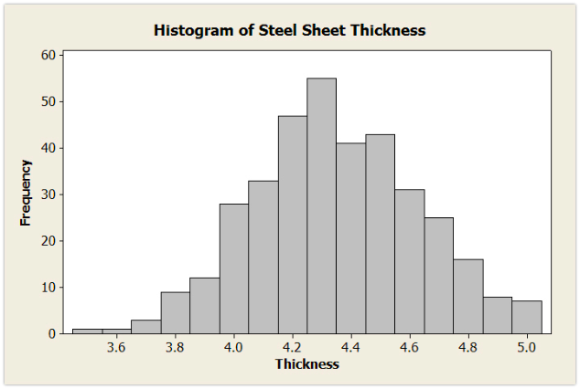
DATA SUMMARISATION AND PRESENTATION
  PIE CHARTS
  HISTOGRAM

Slide 21
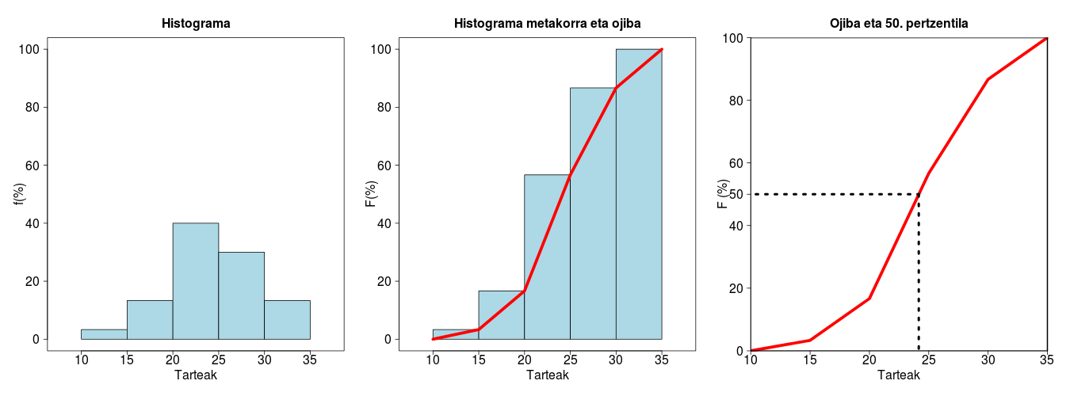
DATA SUMMARISATION AND PRESENTATION
  OGIVE (FOR CUMULATIVE DISTRIBUTION): PREPARES A LESS-THAN-CUMULATIVE DISTRIBUTION
HISTOGRAM
CUMULTATIVE HISTOGRAM
OGIVE
STUDENT SCORES
STUDENT SCORES
STUDENT SCORES

Slide 22

Descriptive Statistics
The farthest most people ever get

Slide 23
DESCRIPTIVE STATISTICS
DESCRIPTIVE STATISTICS ARE USED BY RESEARCHERS TO REPORT ON SAMPLE OR POPULATION DATA
IN SOCIOLOGY: SUMMARY DESCRIPTIONS OF MEASUREMENTS (VARIABLES) TAKEN ABOUT A GROUP OF PEOPLE
BY SUMMARIZING INFORMATION, DESCRIPTIVE STATISTICS SPEED UP AND SIMPLIFY COMPREHENSION OF A GROUP’S CHARACTERISTICS

Slide 24
DESCRIPTIVE STATISTICS
An Illustration:
Which Group is Smarter?
Class A--IQs of 13 Students
102 115
128 110
131 89
89 106
140 119
109 97
110
Class B--IQs of 13 Students
127 162
131 131
127 111
80 109
105 87
120 105
109
Each individual may be different. If you try to understand a group by remembering the qualities of each member, you become overwhelmed and fail to understand the group.

Slide 25
DESCRIPTIVE STATISTICS
Which group is smarter now?
Class A--Average IQ Class B--Average IQ
111.15 115.69
CLASS B TENDS TO BE A BIT SMARTER!
With a summary descriptive statistic, it is much easier to answer our question.

Slide 26
FREQUENCY DISTRIBUTION
Class A--IQs of 13 Students
102 115
128 110
131 89
89 106
140 119
109 97
110
NO OF STUDENTS IN CLASS A: 13
IQ | FREQUENCY
89 | 2
97 | 1
102 | 1
106 | 1
109 | 1
110 | 2
115 | 1
119 | 1
128 | 1
131 | 1
140 | 1
TOTAL | 13

Slide 27
GROUPED FREQUENCY DISTRIBUTION
Class A--IQs of 13 Students
102 115
128 110
131 89
89 106
140 119
109 97
110
NO OF STUDENTS IN CLASS A: 13
IQ | FREQUENCY
80-90 | 2
90-100 | 1
100-110 | 3
110-120 | 4
120-130 | 1
130-140 | 1
140-150 | 1
TOTAL | 13
WE JUST SUMMARIZED A BIG FREQUENCY TABLE
INTO A SMALL GROUPED FREQ TABLE.
GROUPING INCREASES READABILITY

Slide 28
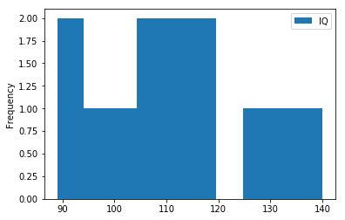
HISTOGRAM:
DEPICTS FREQUENCY DISTRIBUTION OF DATA SET

Slide 29
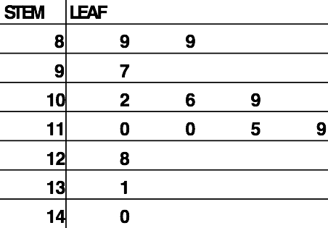
STEM AND LEAF PLOT
Class A--IQs of 13 Students
102 115
128 110
131 89
89 106
140 119
109 97
110
NO OF STUDENTS IN CLASS A: 13

Slide 30
DESCRIPTIVE STATISTICS: SUMMARIZING DATA
  CENTRAL TENDENCY (OR GROUPS’ “MIDDLE VALUES”)
    MEAN
    MEDIAN
    MODE
  DISPERSION (OR SUMMARY OF DIFFERENCES WITHIN GROUPS)
    RANGE
    INTERQUARTILE RANGE
    VARIANCE
    STANDARD DEVIATION

Slide 31
MEAN
TERRIFIED TO SEE ALL THESE SYMBOLS? DON’T BE….
Y-bar = (Y1 + Y2 + . . . + Yn)
n
Y-bar = Σ Yi
n
Some Symbolic Conventions in this Class:
Y = your variable (could be X or Q or ☺ or even “Glitter”)
“-bar” or line over symbol of your variable = mean of that variable
Y1 = first observation
“. . .” = ellipsis = continue sequentially
Yn = last observation
n = number of observations in your sample
Σ = Greek letter “sigma” = sum or add up what follows
i = a typical case or each case in the sample (1 through n)

Slide 32
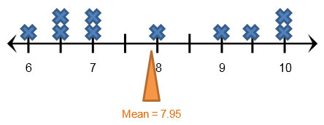
MEAN
MEAN IS LIKE THE BALANCE POINT….
ALSO CALLED EXPECTED VALUE (SINCE MEAN SUMMARISES ALL THE OBSERVATIONS IN THE DATA)

Slide 33
MEDIAN
THE MIDDLE VALUE WHEN A VARIABLE’S VALUES ARE RANKED IN ORDER; THE POINT THAT DIVIDES A DISTRIBUTION INTO TWO EQUAL HALVES
WHEN DATA ARE LISTED IN ORDER, THE MEDIAN IS THE POINT AT WHICH 50% OF THE CASES ARE ABOVE AND 50% BELOW IT
ALSO CALLED THE THE 50TH PERCENTILE

Slide 34
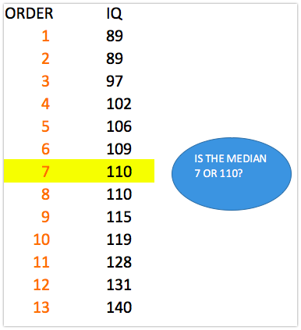
MEDIAN
Class A--IQs of 13 Students
102 115
128 110
131 89
89 106
140 119
109 97
110
NO OF STUDENTS IN CLASS A: 13

Slide 35
MEDIAN
THE MEDIAN IS UNAFFECTED BY OUTLIERS, MAKING IT A BETTER MEASURE OF CENTRAL TENDENCY, BETTER DESCRIBING THE “TYPICAL PERSON” THAN THE MEAN WHEN DATA ARE SKEWED
All of Us
Bill Gates
outlier
MEDIAN
MEAN

Slide 36
MEDIAN
IF THE RECORDED VALUES FOR A VARIABLE FORM A SYMMETRIC DISTRIBUTION, THE MEDIAN AND MEAN ARE IDENTICAL
IN SKEWED DATA, THE MEAN LIES FURTHER TOWARD THE SKEW THAN THE MEDIAN
Symmetric
Skewed
Mean
Mean
Median
Median

Slide 37
MODE
THE MOST COMMON DATA POINT IS CALLED THE MODE.
THE COMBINED IQ SCORES FOR CLASSES A & B:
80 87 89 93 93 96 97 98 102 103 105 106 109 109 109 110 111 115 119 120
127 128 131 131 140 162
**IT IS POSSIBLE TO HAVE MORE THAN ONE MODE!**

Slide 38
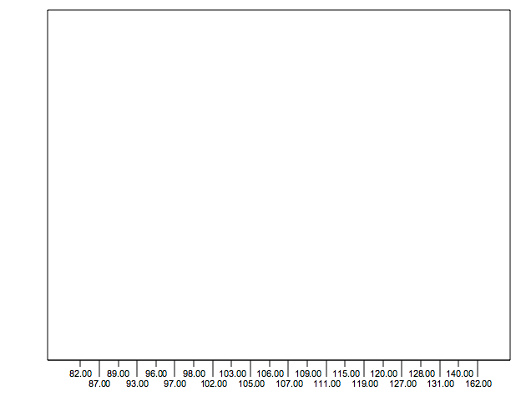
MODE
IT MAY NOT BE AT THE CENTER OF A DISTRIBUTION.
DATA DISTRIBUTION ON THE RIGHT IS “BIMODAL” (EVEN STATISTICS CAN BE OPEN-MINDED)

Slide 39
MODE
IT MAY GIVE YOU THE MOST LIKELY EXPERIENCE RATHER THAN THE “TYPICAL” OR “CENTRAL” EXPERIENCE
IN SYMMETRIC DISTRIBUTIONS, THE MEAN, MEDIAN, AND MODE ARE THE SAME
IN SKEWED DATA, THE MEAN AND MEDIAN LIE FURTHER TOWARD THE SKEW THAN THE MODE
Symmetric
Skewed
Mean
Median
Mode
Mode
Median
Mean

Slide 40
PROBLEMS
Situation A
There are three different basketball teams and each has played five games. You have each team's score from each of its games:
TEAMS | GAME 1 | GAME 2 | GAME 3 | GAME 4 | GAME 5
JAGUARS | 67 | 87 | 54 | 99 | 78
WOLVES | 85 | 90 | 44 | 80 | 46
LIONS | 32 | 101 | 65 | 88 | 55
SUPPOSE YOU WANT TO JOIN ONE OF THE THREE BASKETBALL TEAMS. YOU WANT TO JOIN THE ONE THAT IS DOING THE BEST SO FAR. IF YOU RANK EACH TEAM BY THEIR MEAN SCORES, WHICH TEAM WOULD YOU JOIN?
INSTEAD OF USING MEAN SCORES, YOU USE THE MEDIAN SCORE OF EACH TEAM TO MAKE YOUR DECISION. WHICH TEAM DO YOU JOIN?
PRETEND YOU ARE THE COACH OF THE LIONS AND YOU WERE BEING INTERVIEWED ABOUT YOUR TEAM FOR THE LOCAL NEWSPAPER. WOULD IT BE BETTER FOR YOU TO REPORT YOUR MEAN SCORE OR YOUR MEDIAN SCORE?

Slide 41
DESCRIPTIVE STATISTICS
  CENTRAL TENDENCY (OR GROUPS’ “MIDDLE VALUES”)
    MEAN
    MEDIAN
    MODE
  DISPERSION (OR SUMMARY OF DIFFERENCES WITHIN GROUPS)
    RANGE
    INTERQUARTILE RANGE
    VARIANCE
    STANDARD DEVIATION

Slide 42
RANGE
THE SPREAD, OR THE DISTANCE, BETWEEN THE LOWEST AND HIGHEST VALUES OF A VARIABLE.
TO GET THE RANGE FOR A VARIABLE, YOU SUBTRACT ITS LOWEST VALUE FROM ITS HIGHEST VALUE.
Class A--IQs of 13 Students
102 115
128 109
131 89
98 106
140 119
93 97
110
Class A Range = 140 - 89 = 51
Class B--IQs of 13 Students
127 162
131 103
96 111
80 109
93 87
120 105
109
Class B Range = 162 - 80 = 82

Slide 43
INTERQUARTILE RANGE
A QUARTILE IS THE VALUE THAT MARKS ONE OF THE DIVISIONS THAT BREAKS A SERIES OF VALUES INTO FOUR EQUAL PARTS.
THE MEDIAN IS A QUARTILE AND DIVIDES THE CASES IN HALF.
25TH PERCENTILE IS A QUARTILE THAT DIVIDES THE FIRST ¼ OF CASES FROM THE LATTER ¾.
75TH PERCENTILE IS A QUARTILE THAT DIVIDES THE FIRST ¾ OF CASES FROM THE LATTER ¼
USE THE SAME FUNDA TO CALCULATE Q1 AND Q3 WHICH WE USED TO CALCULATE Q2 (OR MEDIAN)
  INSTEAD OF DOING 0.5 *(N+1); DO 0.25*(N+1) FOR Q1 AND 0.75*(N+1) FOR Q3

Slide 44
INTERQUARTILE RANGE
THE INTERQUARTILE RANGE IS THE DISTANCE OR RANGE BETWEEN THE 25TH PERCENTILE AND THE 75TH PERCENTILE. BELOW, WHAT IS THE INTERQUARTILE RANGE?
25% of cases
25% of cases
25% of cases
25% of cases
0 250 500 750 1000
IQR = Q3 – Q1

Slide 45
VARIANCE
A MEASURE OF THE SPREAD OF THE RECORDED VALUES ON A VARIABLE. A MEASURE OF DISPERSION.
THE LARGER THE VARIANCE, THE FURTHER THE INDIVIDUAL CASES ARE FROM THE MEAN.
THE SMALLER THE VARIANCE, THE CLOSER THE INDIVIDUAL SCORES ARE TO THE MEAN.
VARIANCE
Mean
VARIANCE
Mean

Slide 46
VARIANCE
VARIANCE IS A NUMBER THAT AT FIRST SEEMS COMPLEX TO CALCULATE.
CALCULATING VARIANCE STARTS WITH A “DEVIATION.”
A DEVIATION IS THE DISTANCE AWAY FROM THE MEAN OF A CASE’S SCORE.
YI – Y-BAR
I BOUGHT A CAR IN $6,000. IF THE AVERAGE PERSON’S CAR COSTS $10,000, MY DEVIATION FROM THE MEAN IS - $4,000!
6K - 10K = -4K

Slide 47
VARIANCE
THE DEVIATION OF 102 FROM 110.54 IS? DEVIATION OF 115?
Class A--IQs of 13 Students
102 115
128 109
131 89
98 106
140 119
93 97
110
Y-bar_{A} = 110.54

Slide 48
VARIANCE
THE DEVIATION OF 102 FROM 110.54 IS? DEVIATION OF 115?
102 - 110.54 = -8.54 115 - 110.54 = 4.46
Class A--IQs of 13 Students
102 115
128 109
131 89
98 106
140 119
93 97
110
Y-bar_{A} = 110.54

Slide 49
VARIANCE
WE WANT TO ADD THESE TO GET TOTAL DEVIATIONS, BUT IF WE WERE TO DO THAT, WE WOULD GET ZERO EVERY TIME. WHY?
WE NEED A WAY TO ELIMINATE NEGATIVE SIGNS.
SQUARING THE DEVIATIONS WILL ELIMINATE NEGATIVE SIGNS...
A DEVIATION SQUARED: (Yi – Y-bar)²
BACK TO THE IQ EXAMPLE,
A DEVIATION SQUARED FOR 102 IS: OF 115:
(102 - 110.54)² = (-8.54)² ⁼ 72.93 (115 - 110.54)² = (4.46)² = 19.89

Slide 50
VARIANCE
IF YOU WERE TO ADD ALL THE SQUARED DEVIATIONS TOGETHER, YOU’D GET WHAT WE CALL THE
“SUM OF SQUARES.”
Sum of Squares (SS) = Σ (Yi – Y-bar)²
SS = (Y1 – Y-bar)² + (Y2 – Y-bar)² + . . . + (Yn – Y-bar)²

Slide 51
VARIANCE
The last step…
The approximate average sum of squares is the variance
SS/N = Variance for a population
SS/n-1 = Variance for a sample
Variance = Σ(Yi – Y-bar)² / n – 1

Slide 52

VARIANCE
For Class A, Variance = 2825.39 / n - 1
= 2825.39 / 12 = 235.45
How helpful is that???

Slide 53
STANDARD VARIATION
TO CONVERT VARIANCE INTO SOMETHING OF MEANING, LET’S CREATE STANDARD DEVIATION
THE SQUARE ROOT OF THE VARIANCE REVEALS THE AVERAGE DEVIATION OF THE OBSERVATIONS FROM THE MEAN
S.D. = Σ(Yi– Y-bar)²
n - 1

Slide 54
STANDARD VARIATION
For Class A, the standard deviation is:
235.45 = 15.34
The average of persons’ deviation from the mean IQ of 110.54 is 15.34 IQ points.
Review:
1. Deviation
2. Deviation squared
3. Sum of squares
4. Variance
5. Standard deviation

Slide 55
STANDARD VARIATION
  Larger s.d. = greater amounts of variation around the mean.
For example:
19 25 31 13 25 37
Y-bar = 25 Y-bar = 25
s.d. = 3 s.d. = 6
  s.d. = 0 only when all values are the same (only when you have a constant and not a “variable”)
  If you were to “rescale” a variable, the s.d. would change by the same magnitude—if we changed units above so the mean equaled 250, the s.d. on the left would be 30, and on the right, 60
  Like the mean, the s.d. will be inflated by an outlier case value.

Slide 56
VARIANCE AND STANDARD VARIATION IN REAL LIFE…
A CLASS OF STUDENTS TOOK A MATH TEST. THEIR TEACHER FOUND THAT THE MEAN SCORE ON THE TEST WAS AN 85%. SHE THEN CALCULATED THE STANDARD DEVIATION OF THE OTHER TEST SCORES AND FOUND A VERY SMALL STANDARD DEVIATION WHICH SUGGESTED THAT MOST STUDENTS SCORED VERY CLOSE TO 85%
A DOG WALKER WANTS TO DETERMINE IF THE DOGS ON HIS ROUTE ARE CLOSE IN WEIGHT OR NOT CLOSE IN WEIGHT. HE TAKES THE AVERAGE OF THE WEIGHT OF ALL TEN DOGS. HE THEN CALCULATES THE VARIANCE, AND THEN THE STANDARD DEVIATION. HIS STANDARD DEVIATION IS EXTREMELY HIGH. THIS SUGGESTS THAT THE DOGS ARE OF MANY VARIOUS WEIGHTS, OR THAT HE HAS A FEW DOGS WHOSE WEIGHTS ARE OUTLIERS THAT ARE SKEWING THE DATA
A MARKET RESEARCHER IS ANALYZING THE RESULTS OF A RECENT CUSTOMER SURVEY. HE WANTS TO HAVE SOME MEASURE OF THE RELIABILITY OF THE ANSWERS RECEIVED IN THE SURVEY IN ORDER TO PREDICT HOW A LARGER GROUP OF PEOPLE MIGHT ANSWER THE SAME QUESTIONS. A LOW STANDARD DEVIATION SHOWS THAT THE ANSWERS ARE VERY PROJECTABLE TO A LARGER GROUP OF PEOPLE

Slide 57
DESCRIPTIVE STATISTICS
  CENTRAL TENDENCY (OR GROUPS’ “MIDDLE VALUES”)
    MEAN
    MEDIAN
    MODE
  DISPERSION (OR SUMMARY OF DIFFERENCES WITHIN GROUPS)
    RANGE
    INTERQUARTILE RANGE
    VARIANCE
    STANDARD DEVIATION
  THERE’S MORE….

Slide 58
BOX PLOTS
A WAY TO GRAPHICALLY PORTRAY ALMOST ALL THE DESCRIPTIVE STATISTICS AT ONCE IS THE BOX-PLOT.
ALSO CALLED BOX AND WHISKER PLOTS
A BOX-PLOT SHOWS: UPPER AND LOWER QUARTILES
MEAN
MEDIAN
RANGE
OUTLIERS

Slide 59
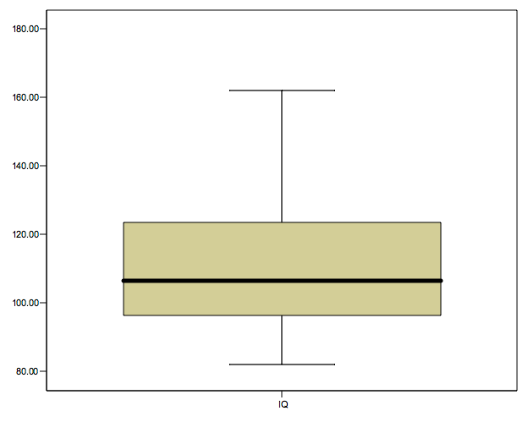
BOX PLOTS
WHAT’S THE IQR???
162
MAXIMUM
UPPER WHISKER
123.5
Q3
M=110.5
106.5
Q2 (ALSO CALLED?)
96.5
Q1
LOWER WHISKER
82
MINIMUM

Slide 60
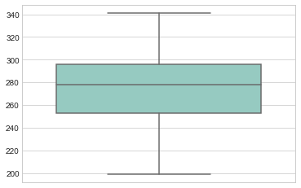
BOX PLOTS
EXAMPLE:
LET THE DATA RANGE BE : 199, 201, 236, 269,271,278,283,291, 301, 303, AND 341
THEREFORE N=11
NOW: CALCULATE Q1, Q2, Q3, Q4 AND IQR
Created using seaborn library

Slide 61

DESCRIPTIVE STATISTICS
CONGRATS… YOU HAVE QUALIFIED DESCRIPTIVE STATISTICS!
LET’S HAVE QUESTIONS?

